Slide 1
Creating Science
Teacher professional development program for early childhood teachers.
Proudly presented by Dr Joseph Ireland PhD – Inquiry Learning (QUT)

Slide 2
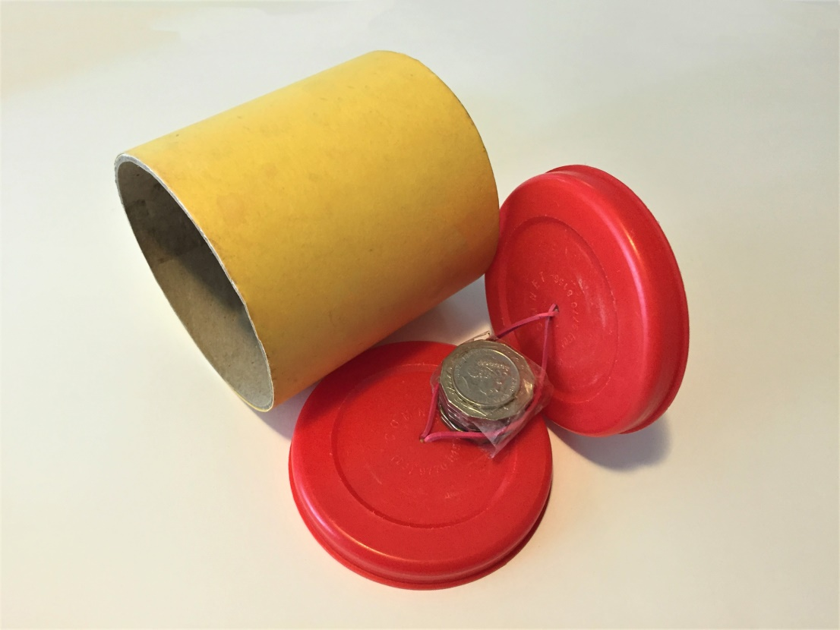
The Returning Roller

Slide 3
Write down what you think is meant by the phrase:
“Scientific knowledge is created.”
Notes:
The philosophy of science in teaching
Q: What is the first thing a scientist needs?
A: Questions: It starts with questions. It doesn’t start with activities, it doesn’t start with science gear, it doesn’t even start with an aim. It starts with questions. (Demonstration of the returning roller).
Write down what you think is meant by the phrase “Scientific knowledge is created.”
Scientists and students make understanding. Just like politics or crime research. (Science as “argument” used in primary connections work.) Scientific knowledge isn’t ‘discovered’, and we don’t think it’s revealed. A postmodern perspective informed by … holds that we must make up the science, therefore, scientific knowledge is created.
And even more importantly in this context, scientific knowledge is being created and recreated inside the minds of your students every day!

Slide 4
How scientific knowledge is created
Question and Predict
Plan and Conduct
Process and Analyse
Evaluate the activity
Communicate your conclusions
Repeat!
Notes:
How scientific knowledge is created.
(for example, using the air powered rocket)
Questions
Theories
Experiments
Conclusions
Communicate
(There is more to that, but it will do for our purposes today)
Most impressively, this is the Australian national curriculum

Slide 5
Science with Purpose!
Help students see the purpose of science!!
Find a cause or problem they are passionate about
Research it, look for solutions
Test out the solution
Come to a conclusion
Tell everyone why it matters!
Science is in everything we do, all the time!
We need to know science for the rest of our lives!
Notes:
Help students see the purpose of science
Find a cause or problem they are passionate about
Research it, look for solutions
Test out the solution
Come to a conclusion
Tell everyone why it matters!

Slide 6
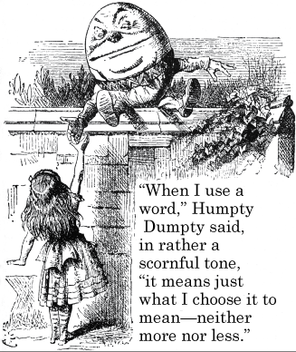
Points to ponder from the scientific glossary
What do these words mean?
Science:
Theory:
Hypothesis
Experiment:
Prediction:
Research:
Inquire:
Notes:
Answers:
Science: A way of knowing the world. Somewhat uniquely, it TESTS all claims. It’s success is enormous.
Theory: An explanation of how the world works, or how to work the world.
Hypothesis: a new, undersupported, theory
Experiment: to create knowledge by testing predictions
Prediction: a guess of what will happen based on your underlying theory
Research: to gather knowledge in order to create knowledge.
Inquire: to ask a question. Diverse from ‘inquiry teaching’ and ‘inquiry learning’.
More detail from the points to ponder from the scientific glossary:
So if we’re going to create knowledge, it’s better if we’re on the same page regarding what we’re talking about.
Experiments are made to test ideas (specifically, theories).
Experiments don’t “fail”.
Science is based on evidence, not expert opinion (who, what, how).
Science is (Observe), question, explain, predict and test, conclude, publish. Not aim, material method etc., that’s experimental write-up so that others can try out your science.
However, did you know that experiments aren’t the only way to do science!
Lederman (2004) cites 3 general levels of scientific inquiry; Descriptive (closely observing a situation, common to anatomy and taxonomy for instance), Correlational (comparing information for patterns, common to sociology for instance), and Experimental (discussed here as creating and testing ideas about the world).
Experiments aren’t demonstrations (testing a theory v’s demonstrating it).
Experiments aren’t tests (testing a theory v’s just seeing what will happen).
Fair tests are experiments set up so that we know what we’re testing!
Theories aren’t guesses. They are explanations or, in my words, ‘science stories’ of how the world works. Scientific theories cannot be directly tested, but we can test the predictions that result from those theories. Theories include the theory of gravity, theory of evolution, or germ theory.
Theories usually start with the word ‘because’…
And require evidence to be accepted in science.
Hypothesis aren’t predictions. Hypothesis are baby theories that haven’t been tested much or are based on only a few observations. Hypothesis can grow into well accepted theories if they pass many tests.)
They also usually start with the word ‘because’.
Predictions are guesses at what your results will be. To some, you need a prediction to know you’re doing an experiment.
(Extra bonus from the philosophy of science)
Scientific laws aren’t “true” – they are just another kind of theory that must be tested, and will be rejected if they fail the tests. Scientific laws are used to specify a particular relationship in nature, and are usually written using mathematics. Laws include the gas law which explains the relationship between pressure and temperature, or the laws of motion which explain the relationship between force, mass and acceleration.
Observation isn’t inference. What you perceive (observation), and how you make sense of what you perceive (inference) are very different things.
The rocket balloon flew around, that is what you observed. But why did it fly around? That is your inference, or in other words, your theory.
There are two very general bodies of science: core and frontier.
Core science is very well established, used and agreed on by large numbers of scientists, and resistant to change. Core science includes atomic theory, genetic theory, and in spite of protests to the contrary – evolutionary theory.
Frontier science is new, often hotly contested, sometimes controversial and for that reason much more popular and publicised than core science – making many people feel that frontier science is the only science.
Demonstration of the rocket balloon (some science concepts are crazy, but they work, so we are obliged to keep them).
(Back to the curriculum then!)

Slide 7
So what is inquiry teaching (according to teachers)
Inquiry as experiences – making science engaging and hands on.
Inquiry as problems – helping students to be problem solvers.
Inquiry as student questions – helping students to ask and answer their own questions.
Yet, for all this, we were not Creating Science!
Notes:
So what is inquiry? Review of Ireland et al. (2012) – This is not my key point, but I want you to think about it.
There is a lot of fuss about this ‘inquiry teaching’, so I did my doctoral research to find out what teachers meant when they said “I’m teaching science through inquiry.” I found there were three things that teachers actually meant;
Category 1 summary: Student Centred Experiences
Inquiry teaching is experienced as Student Centred Experiences (Category 1) when teachers structure their teaching around a concern for students’ personal experiences during learning with a focus on sensory events. That is, there is an expectation that the students will see, hear, feel and do interesting things that will focus their attention, have them asking science questions, and improve their engagement in learning. The teacher sets up opportunities for students to capitalise on their curiosity and to ask questions about their experiences.
Examples presented by teachers included growing tomato plants in various conditions to observe what qualities made them flourish (T1), playing with live worms after reading about them (T5), and watching videos about volcanoes to highlight science content material (T20). Examples of this category also included allowing students unstructured play with equipment during a science lesson (T3, T4, T5), as free choice activities during students’ free time (T16), or when teachers teach students how to perform an activity and allow them to re-perform it before school (T6, T9). Scientific proofs, that is, science content demonstrations by teachers or students making use of experimental procedures to obtain expected results, also belonged to this category (T6, T12).
Category 2 summary: Teacher Generated Problems
Inquiry teaching is experienced as Teacher Generated Problems (Category 2) when teachers structure their teaching around a given problem they have designed and that the students are required to solve. The problem is central to the teaching experience as teachers feel it helps students engage with the topic at hand and produce productive work. In this category, teachers expect students will have greater ownership over the content material covered than other teaching methods through resolving the problem themselves.
Examples include: working out how to lift a heavy box using only a cylinder and plank (T14); responding to an imaginary letter from an underwater theme park world for information on how to set up a new exhibit (T18); building a tower using paper and sticky tape that would support a tennis ball (T10); setting students the task to find out about natural disasters (T17) from the internet or library. Examples may also include designing, building and testing energy efficient shoebox houses (T4); testing water absorption into the atmosphere (T15); developing tests to compare towel absorbency (T16); measuring viscosity, the co-efficient of bouncing, or the hardness of rocks (T7).
Category 3 summary: Student Generated Questions
Inquiry teaching is experienced as Student Generated Questions (Category 3) when teachers structure their teaching around helping students to ask and answer their own questions about phenomena. The students’ questions are central to the teaching experience as teachers see students as being more motivated and engaged with science content and materials when they are seeking to answer their own questions than with traditional teaching methods.
Examples of this category include negotiating a topic with students, such as under the sea (T6, T18) or micro-beasts (T8), then organising students to generate questions and research their answers within that topic. This category also includes scientific investigations where the teacher selects the topic, but helps students to generate and answer their own questions in relation to that topic, such as developing a way of testing advertising claims for superior products (T4), or exploring the qualities of successful balloon rockets (T2). The focus is on helping students to ask and answer their own questions.
“However, teacher beliefs regarding the nature of student understanding of scientific knowledge did not differ among categories. In all categories, knowledge is gathered rather than created, though the process of gathering that knowledge did differ between categories; from watching demonstrations or experiencing materials in the Student Centred Experiences category, through solving a problem during the Teacher Generated Problems category, to concluding (correctly) on the results of their own investigations during the Student Generated Questions category.”
”Teachers acted as though a correct answer was waiting to be found in science (Section 4.5.3 teachers role, epistemological beliefs), rather than being created and tested through scientific processes of knowing (Prosser et al., 1994; Samuelowicz & Bain, 1992). “ – p156
Pg 158 is particularly important:
Teacher epistemological beliefs around the source of knowledge, being from expert opinion or student’s analysis of evidence, has been mentioned as one of the more significant findings of this study. From the definition of Eastwell (2008); “An inquiry activity is one that requires students to answer a scientific question by analysing raw, empirical data themselves” (p. 31), it can be seen that all categories in this study involve answering a question (student or teachers’) and all involve students interpreting data. Thus, according to this definition, all forms of inquiry represented in this thesis are potentially inquiry. The difficulty lies in teacher epistemological beliefs – students were concluding what teachers expected, even incorrectly, rather than using evidence and logic as the source of knowledge as this definition seems to imply. This failure to meet the epistemological standards of the literature is the motivation behind the NOS movement, especially with regards to evidence as opposed to authority based decision making (Osborne & Collins, 2003). Several studies strive to place evidence highly as an epistemological standard in science, for example, “Students using evidence to defend their conclusions.” (Harwood et al., 2006, p. 72) and “Learner gives priority to evidence” (National Research Council of America, 2000, p. 42). Even certain definitions of scientific literacy require students to be able to “draw evidence-based conclusions” (Goodrum et al., 2001, p. ix).
Teachers appear to be looking for a fun, hands on activity that engages students and potentially helps make them better people. Teacher educators are looking to train a scientifically literate generation (Goodrum et al., 2001), through student experiences that are more closely aligned with authentic science (Chinn & Hmelo-Silver, 2002) and require students to create knowledge rather than absorb it in new and entertaining ways (Colburn, 2000). Part of the reason for this difference in aims could be the differences in epistemological beliefs of teachers and teacher educators. Teachers appear to have limited epistemological beliefs with regards to science: using it to prove a point rather than test an idea, using creativity to explore content but not to create or test hypothesis. Section 5.5, recommendations, continues the discussion regarding this gap and potential ways to bridge teacher and teacher educators’ expectations for inquiry teaching.
Each conception had its benefits and place in the curriculum, however, those teachers which focused on helping students to ask and answer their own student questions were describing a curriculum that was more aligned with contemporary educational objectives. Also, the categories were hierarchical, experience centred teachers tended to stay with simply experiences, while question centred teachers would use all other conceptions at different times.
Questions are the basis of science. Questions not only help you to determine what students are actually learning; the questions you, your students, and future scientists ask will determine what science becomes in the future.

Slide 8
Make it real
Recommendations to assist teachers in helping students to become creators of scientific knowledge :
During a demonstration, PAUSE to ask what they think will happen and why.
Get students to EXPLAIN their results. Have them JUSTIFY why they choose to believe this. This is what it takes to make science as an argument (I prefer debate).
Don’t be afraid to NOT KNOW. Science begins with not knowing (i.e., with questions). Honest ignorance is always better than false knowledge.
STOP to explain who came up with this theory, and how they convinced the world. Theories belong to people!
MAKE your explanations tentative – just like real science. It’s not about memorising other people’s ideas, but about learning why and what and how they convinced us, and if they’ve convinced you! (Sandoval, 2005 , Furtak, 2006).
Encourage questions! Ever answer is really just a new question in science!
Notes:
You folks are going to run circles around me here – you already know more about early childhood learning than I do, and you already know more about creating knowledge in the early childhood settings. What are your suggestions?
From my doctoral research, six specific recommendations are here proposed which could assist teachers to implement Category 3. They are: (a) Making teachers aware of the categories of conceptions uncovered in this study; (b) Making use of the KWL technique in science education; (c) Challenging teacher epistemological beliefs to allow the source of knowledge in science education to be evidence and not just expert opinion, thus allowing students to be creators and not just consumers of knowledge; (d) Using more appropriate terminology in the classroom (i.e., ‘experiment’, and ‘hypothesis’, to begin with); (e) During inquiry units based on the 5E’s method, making special effort to validate and explore student generated questions during the explore and elaborate phases; (f) helping teachers see how Category 3 can be successfully applied at all year levels.

Slide 9
Science is Everywhere!
Science is in EVERYTHING we do!
We want kids to know only know science, but to know that we ‘test ideas’ and ‘ask questions’.
The BEST science is happening in EARLY CHILDHOOD!

Slide 10
Look again at your definition from the start of the phrase “scientific knowledge is created.”
The gap in the study: Science is all about generating questions and testing ideas.
When a teacher is presenting science as ‘facts to be memorised’ rather than ‘ideas to be tested’ they might be teaching about science, but their students aren’t doing science.

Slide 11
How can we help our students become testers of scientific ideas, rather than memorisers of other people’s thoughts?

Slide 12
Pedagogical Content Knowledge
Physical Sciences – Magnet racers
Chemical Science – Bubble worms
Life Sciences – Bug sukka
Earth and Space Sciences – Sedimentary sculpture
Notes:
4 stations, do, then share:
Physical Sciences – Magnet racers
Chemical Science – Bubble worms
Life Sciences – Bug sukka
Earth and Space Sciences – Sedimentary sculpture
Then free time to chat to me, explore and play.
Senses
Motion
Life

Slide 13
Now, GO!
How do we implement what we have learned today AND track our progress?
can you do your own EXPERIMENT on teaching science better?
what have your learnt?
what will you try better?
How?
how will you record your progress?
when do you plan to review your results?

Slide 14
Cycle of Inquiry

Slide 15
Notes

Slide 16
Putting student questions into the centre of the curriculum.
Discuss ways in which you can put student questions at the centre of your curriculum:
Have an engage activity and write down student questions.
Have a question book and leave it open, or a poster, or a page in their books.
Have a wonder corner where they can redo activities in their own time.
Have free time at recess.
Notes:
Improving wonder: Stop, and ask, ‘what do you think will happen’ – then if you’re into hypothesis testing, try to have them answer ‘and why do you think it will happen that way’?

Slide 17
Lederman (2004) cites 3 general levels of scientific inquiry;
Descriptive (closely observing a situation, common to anatomy and taxonomy , etc)
Correlational (comparing information for patterns, common to sociology, etc)
Experimental (establishing causal relationships through the control and insolation of the influence of variables)

Slide 18
OUTCOME 4: CHILDREN ARE CONFIDENT AND INVOLVED LEARNERS
1. Children develop dispositions for learning such as curiosity, cooperation, confidence, creativity, commitment, enthusiasm, persistence, imagination and reflexivity
2. Children develop a range of skills and processes such as problem solving, enquiry, experimentation, hypothesising, researching and investigating
3. Children transfer and adapt what they have learned from one context to another
4. Children resource their own learning through connecting with people, place, technologies and natural and processed materials

Slide 19
Questions are the basis of science.
Questions not only help you to determine what your students are actually learning; the questions you, your students, and future scientists ask will determine what science becomes. - Dr Joe.

Slide 20
Science is a people activity
Who invents a theory matters; what’s their background, motives, experience?
How they say it matters, what evidence they have?
What are they actually saying, what does it mean?
Notes:
Science is a people activity;
Who invents a theory matters; what’s their background, motives, experience?
Every science idea ever created was done by a person – who?
What motives did they have? Were they honest motives?
How they say it matters, what evidence they have?
Science ideas must be tested before accepted (this is one way science is different from other ways of knowing).
What are they actually saying, what does it mean?
What did they teach us? Was it electricity, motion, air pressure?
Can this new knowledge be used to predict or work with nature?

Slide 21
Surprise, this is the new curriculum!
Human influences (who)
Inquiry skills (how)
Content (what)

Slide 22
Bibliography
Furtak, E. M. (2006). The problem with answers: An exploration of guided scientific inquiry teaching. Science Education, 90(3), 453-467.
Ireland, J., Watters, J., Brownlee, J., Lupton, M. (2012). Elementary teacher’s conceptions of inquiry teaching: Messages for teacher development. Journal of Science Teacher Education, 23, 2, 159-175. Available at http://eprints.qut.edu.au/45680/ or officially.
Ireland, Joseph E., Watters, James J., Lupton, Mandy., & Lunn, Joanne M., (2014) Approaches to Inquiry Teaching: Elementary Teacher’s Perspectives. International Journal of Science Education.
Lederman, N.G. (2004). Scientific inquiry and science teaching. In L.B. Flick, & N.G. Lederman, (Eds.), Scientific inquiry and nature of science : implications for teaching, learning and teacher education. Dordrecht, Netherlands : Kluwer Academic.
Sandoval, W. A. (2005). Understanding students practical epistemologies and their influence on learning through inquiry. Science Education, 89 (4), 634-656.

